Slide 1
Bug Bounties: The Other Side Of The Coin
Presented By
Jon Aubrey - @SecurityJon

Slide 2
Introduction
#whoami
Helpdesk Analyst
Developer
Network/System Administrator
Penetration Tester
Father
Security Architect
Offensive Security Manager
Bug Hunter

Slide 3
Agenda
Introduction
Introduction
Why run a Bug Bounty?
What happens after you submit a bug?
Frustrations for Researchers
Frustrations for Companies
How to Maximize Your Profits
Q&A

Slide 4
Disclaimer
Introduction
This talk is around how large companies manage Bug Bounty Programmes
It does not apply to every company
The thoughts expressed in this presentation are my own and do not represent my employer
Running a Bug Bounty programme is a process of continuously learning and adapting, mistakes are made along the way

Slide 5
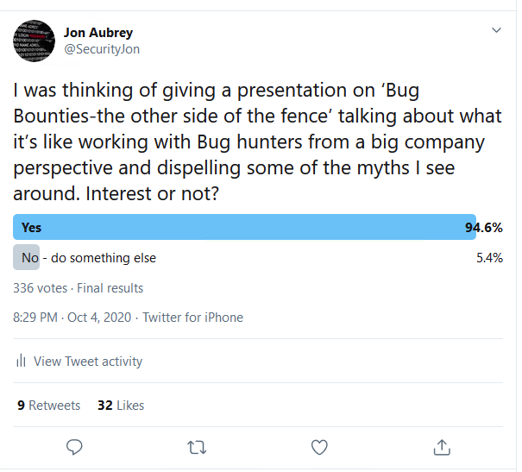
Why do this talk?
Introduction
There are number of talks for Bug Bounty researchers that focus on how to find great bugs, but not so many on what it’s like to receive them
There is a lot of frustration echoed on social media from Bug hunters around dealing with companies that only show one side of the story
There seems to be an interest in the community

Slide 6

Why run a Bug Bounty?
Why run a Bug Bounty?

Slide 7
Reasons
Why run a Bug Bounty?
Because it’s the right thing to do

Slide 8
Reasons
Why run a Bug Bounty?
Because it’s the right thing to do
Because security researchers should be rewarded for their help

Slide 9
Reasons
Why run a Bug Bounty?
Because it’s the right thing to do
Because security researchers should be rewarded for their help
Because it’s another security tool to protect the company

Slide 10
Getting Value
Why run a Bug Bounty?
Company revenue
Budget allocated for Security
Decisions around getting the most value from the funding available
Staff
Tooling
A Bug Bounty is exactly the same as other security tools
Firewalls/Anti-Virus/EDR/Penetration Testing/etc
A tool has to provide more bang-for-the-buck than any other security tool

Slide 11
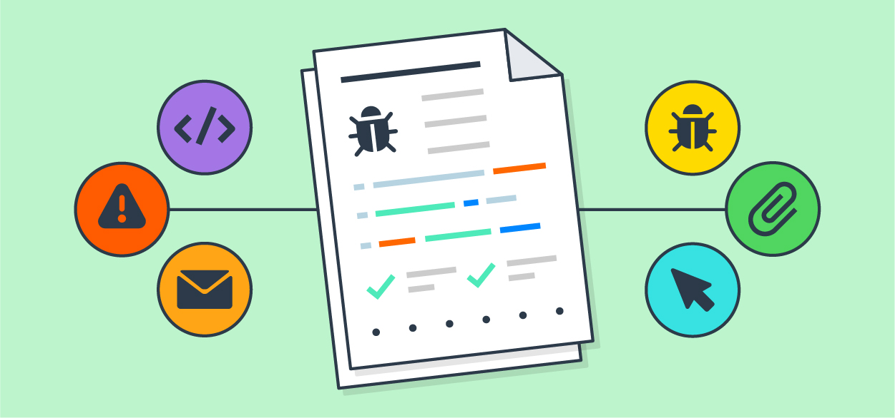
What happens after you submit a bug?
What happens after you submit a bug?

Slide 12
The Process
What happens after you submit a bug?
Triage
Company review the Bug
An amount of time is spend further investigating the issue
The higher the criticality the more time spent on it
Internal incident tickets are created - mapped to a likely owner
If the owner is unclear, many emails are fired around looking for someone who might know
Ticket is moved to the correct owner

Slide 13
How much is a bug worth?
What happens after you submit a bug?
What is the priority for the company?
Financial loss / Customer data / Intellectual property
What is the likelihood of this getting the Bug fixed?
Newer items will have development teams, budget and company incentive to resolve items
Old legacy items may be replaced soon, and may be expensive to fix
The Bug Bounty need to add value, large pay outs for things that can’t or won’t be resolved doesn’t add value

Slide 14
How much is a bug worth?
What happens after you submit a bug?
Sometimes not all of the information is available to make a clear decision
Internal teams don’t want to be delving through sensitive data
They don’t want you doing it either

Slide 15

Frustrations For Researchers
Frustrations for Researchers

Slide 16
Magically Fixed ‘Informational’ Bugs
Frustrations for Researchers
Bug gets submitted
Gets downgraded to ‘informational’ and closed
Magically fixed anyway
Informational Risk = Informational Risk
Standard Patch management happens in the background
Risk = Pay out

Slide 17
Duplicate or Known Issues
Frustrations for Researchers
Bug is marked as duplicate or a known issue
There isn’t another ticket submitted for this though
Bug has been found another way (typically Penetration Test)
Bug Bounty is about adding Security, not removing it
Some bugs are unlikely to be fixed
Don’t paint a target on your own back
Obscurity ++ Security

Slide 18
Duplicate or Known Issues
Frustrations for Researchers
Trade off between annoying researchers and reducing security against the baddies
It is unfair (sorry)

Slide 19
Raining Crits – Taking Away Your Toys
Frustrations for Researchers
You find multiple critical vulnerabilities in an asset
Get asked to stop testing
Only get paid for a few of the Bugs, not all of them
It’s an unknown asset
The asset is clearly very insecure, time for a Penetration Test
The value you added was highlighting the systemic problem
The asset shares a common insecure library across it’s surface
Fix the library, fix the systemic problem
The value you added was identifying the library

Slide 20
Downgrading Vulnerabilities: Critical != Critical
Frustrations for Researchers
Critical vulnerability is downgraded to a ‘low’ or ‘informational’
Weak Creds in Internet Facing Database > Customer Data Exposed
Payday!
Triaged as Critical
Processed as Low
Company != Playing Games

Slide 21
Issues Taking Forever To Close
Frustrations for Researchers
Small Scope = Well Defined Resolving Teams
Large Scope = Could be anyone
Finding a Resolving Team can be hard/impossible
Resolving Teams have to prioritise Bugs against Features
Not Critical?
Into the release cycle

Slide 22
Frustrations For Companies
Frustrations for Companies

Slide 23

Overstepping Bounds
Frustrations for Companies
Defining Risk = Good
Creating Risk = Bad
Notes:
Example of a researcher who:
Brute forced passwords, went into someone’s emails, forgot they’d found a second account details as well as the first.
Massive investigation to determine if they’d gone too far

Slide 24

Chasing for Updates
Frustrations for Companies

Slide 25

How to Maximise Your Profits
How to Maximise Your Profits

Slide 26

Building Rapport
How to Maximise Your Profits
There will be bugs which sit on the fence between two different pay levels
The company gets to decide which level to pay out at
Easy to work with
Enjoyable to work with
More you get paid
Trust = Win

Slide 27
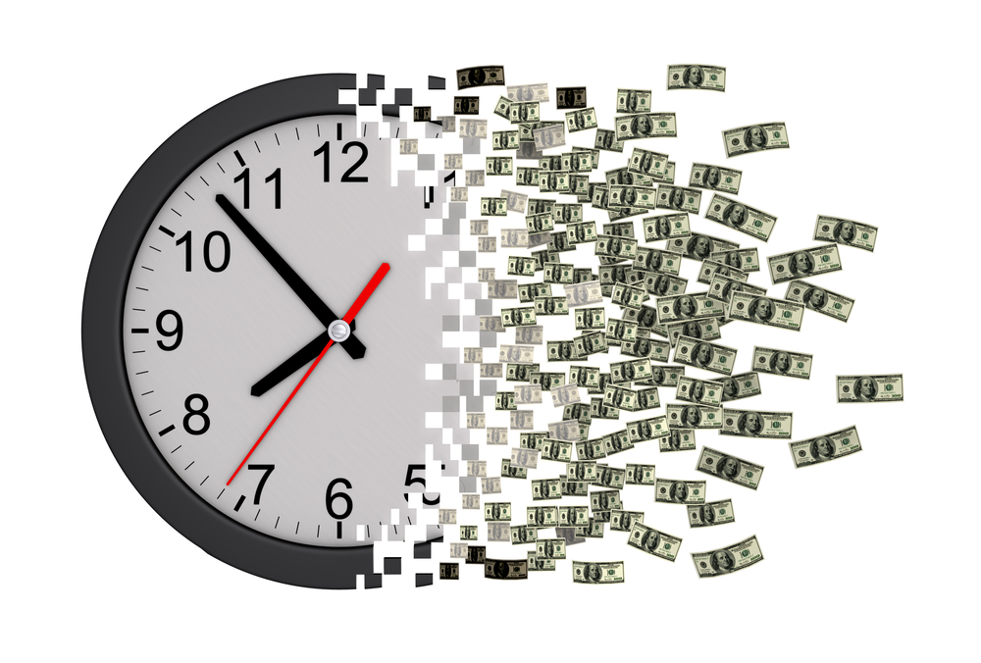
Building Rapport
How to Maximise Your Profits
Company resource to deal with ticket
Time = Money
Replicating issues takes time
A lot of reports will be copy/pasted
Well documented reports make life easy
Easy
Enjoyable
Paid more

Slide 28
Avoiding Duplicates
How to Maximise Your Profits
Keep getting beaten to the punch?
You
Triage
Security Team
Resolving Team
Reports can take days between submission and getting resolved
Get in fast, but have enough information to action
Additional impact can be added before it’s resolved

Slide 29

FIN
Bug Bounties: The Other Side Of The Coin
Jon Aubrey
@SecurityJon

